Slide 1

Intermediate Xbox 360 Development with the XNA Framework
Chris Gardner
Senior Software Engineer
T & W Operations, Inc.

Slide 2
Road Map
Game Components
Drawable Game Components
Sprite Animation
Sound Effects
XACT
Threading

Slide 3
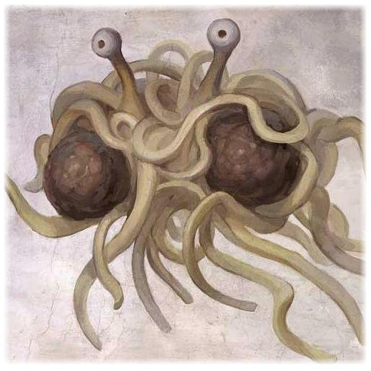
Game Components
AKA: Keeping your game loop to under 1,000,000 line of code

Slide 4
Game Component
A class that gets its own Update
Derived from GameComponent
Add to Components Collection of Game

Slide 5
Drawable Game Components
A class with Update and Draw
Derived from DrawableGameComponent
GameComponent and IDrawable
Also gets a LoadContent

Slide 6
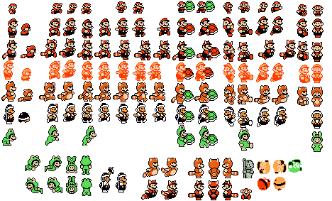
Sprite Animation
AKA: How Nintendo got famous

Slide 7
Sprite Animation
Load Texture2D with entire sprite map
Use overload of SpriteBatch.Draw
Draw( Texture2D, Vector2, Rectangle, Color );
The Rectangle is the Portion of the Texture2D to display

Slide 8

Sound Effects and Audio
AKA: The groove to make your booty move

Slide 9
Sound Effects
Natively add sounds to Content project
Wav, mp3, wma
SoundEffect class
Play()
NOTE: There is no stop.
CreateInstance()
SoundEffectInstance
The world is your pork chop…

Slide 10
XACT

Slide 11
XACT
Cross-Platform Audio Creation Tool
Imports multiple sounds into WaveBanks
Tweak global sound properties
Use WaveBanks to Create SoundBanks
A sound in the sound bank can use multiple waves
Create Cues from the Sounds
Compile into one sound package

Slide 12
XACT
Add compiled XACT files into Project
Load XACT content to game
Use xgs file to create AudioEngine
Use xwb and AudioEngine to create WaveBank
Use xsb and AudioEngine to create SoundBank
Get Cue from engines and play

Slide 13
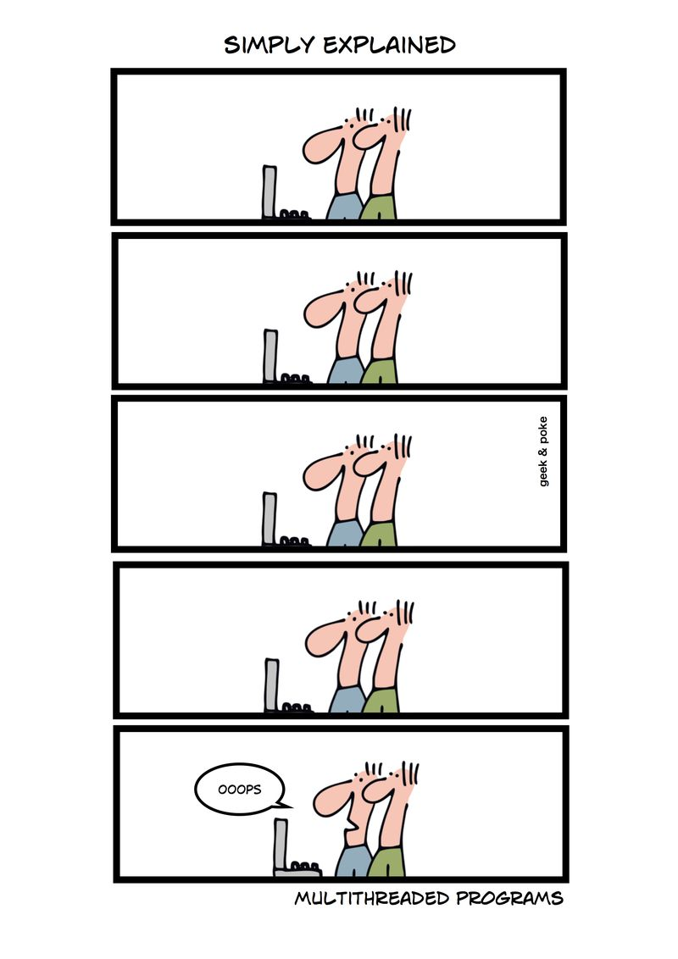
Threading
AKA: Never let your left hand know what your right hand is doing

Slide 14
Threading
System.Threading.Thread
Xbox 360 has 3 Duel-Core Processors
Cores are “labeled” 0 – 5
Cores 0 and 1 are on Processor 0, etc
System reserves Cores 0 and 2
Microsoft won’t say why
Your game starts on Core 1
We think, Microsoft won’t say for sure
Thread.SetProcessorAffinity( params int[] )

Slide 15
Questions?
Thank You
Chris Gardner
cgardner@tnwops.com
http://www.tnwops.com
@freestylecoder
+Chris Gardner
http://blog.freestylecoding.com

